Slide 1

Hospitality & Clubs

Slide 2

Agenda
Challenges in Hospitality & Clubs
Shining Bot Solution Architecture
How Shining Bot addresses your need
Contact details

Slide 3

Challenges in Hospitality & Clubs
Lack of Customer insights
  Do not the insight regarding who are the visitors, their visiting pattern, trend, likes & dislike, etc.
Maintaining Customer Loyalty
  Retaining the loyalty starts with insights, how you measure the loyalty other than simple cards & coupons
Managing individual preferences
  Providing various range of service for individual needs
Conference & Banquet related WiFi issues
  Managing high density WiFi authentication
  Managing bandwidth control for individual users
  Managing concurrent access control

Slide 4
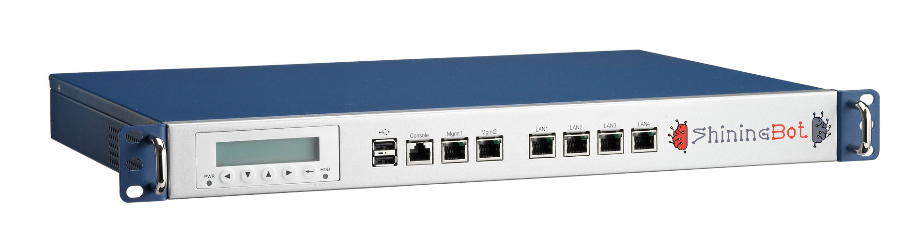
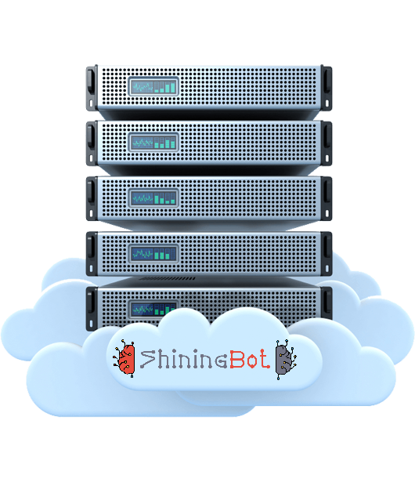




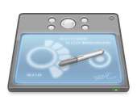
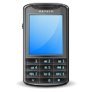
Hardware Architecture
Internet
Access Point
Wireless Controller (Optional)
Server (Optional)
Wireless Clients (Laptop/Tab/Mobile)
Shining Bot Cloud Infrastructure
Customer in-premises Infrastructure

Slide 5












How Shining Bot works …
Customer Profiling & Classification
Registration
Details
Machine
Learning
Check-in
Sign-in
Customer
Data
Source
Check-out
Sign-out
Business Intelligence
& KPI Reports
Internet
Usage
Feedback
Information
Shining Bot
Omicron Engine
Automated Marketing by SMS / WhatsApp / Email

Slide 6



Product Features
Customer Profiling & Classification
Shining Bot Machine Learning Engine profiles customers based on economic status for marketing
Digital Signage
Display full-hd Signages on Android TV using ShiningBot DS television APP and control via web
Self Service Menu, Order & KOT Printing
Manage restaurant, room-service & amenities delivery via automatic self service system using QR Code & Mobile browser
VIP Recognition
Recognize your important customer customers across your outlets and give preferential treatment
Location based Service & Advertisement
Machine Learning Engine understands customer interests based on their location & advertises in login & status pages
Feedback Management
Collect feedback from your customer using Tablet based feedback management system & reports
AI based Automated Marketing
Automatically markets products & services based on the customer interests and preferences
Content Filter
Industry Standard Category based Content Filter with complete user control for URL filtering
Business Intelligence & KPI
Provides advanced reports and Key Performance Indicator data based on the various inputs
Authentication & Log Management
Authenticate users with complete control & Manages logs as per Industry Standard
Application Programming Interface
Extend the Shining Bot capabilities with our API to connect with your customized software

Slide 7
Why Shining Bot …
Exploit the power of Ai & Machine Learning technology for your business development
Provides complete insights about business and operation using WiFi
State of the art solution to improve the business process & profits
Explore the hidden data in your business to exploit the opportunities
It follows your customer even outside your business premises
Increases customer satisfaction by enhancing the experience

Slide 8
How we address the challenges

Slide 9

Making you more aware of your customers/visitors
Shining Bot provides the following insights:
  Registration details (provided by visitor)
  Mobile number (verified by OTP)
  Devices used (Automatic detection)
  Time spent & Visiting pattern & trends
  Locations visited and time spent at each location
Additional insights by Omicron
  Profiling & Classification identifying the economic status
  Product / Service interested in
  Customer Dwell Time – KPI report
  Customer Retention – KPI report
  Customer Satisfaction – KPI report
  Sentiment analysis on feedbacks provided

Slide 10

How it works – Service Provider’s view
User uses the given password to access Internet
ShiningBot Cloud logs usage
  MAC address, Time, Sites Visited
Omicron Engine Generates Additional Information
  Profile customers using devices
  Update frequency & time Analysis
  Sends SMS / WhatsApp alert to users regarding the products/Services
  Location mapping & Movement Analysis
  Generates Consolidation Reports

Slide 11
How it works – User view
User sees WiFi Availability & connects the device
Device Pop-up with Authentication request
User selects “Registration” & Submit required details including Mobile number.
ShiningBot Cloud delivers OTP by SMS
User uses the given password to access Internet
On expiry, ShiningBot forces user to logout

Slide 12
User Authentication Mechanisms

Slide 13
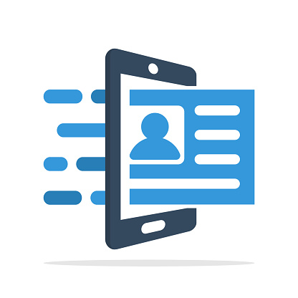
Self Registration with Coupon
WiFi Users register themselves using the registration link available in the login page but need coupon code.
Application
  Café, Restaurant, Hotels, Shopping Mall, Hospitals, etc
Advantages
  Controlled access as coupon required for registration
Challenges
  Requires facility to supply coupons to WiFi Users

Slide 14

Service KIOSK
Self/Assisted registration using KIOSK (one of your computer may also be used as KIOSK).
Application
  Café, Restaurants, Hotels, Shopping Mall, Hospitals, etc
Advantages
  Controlled access as registration done at KIOSK
Challenges
  Requires facility/manpower to help registration

Slide 15

Third Party Software Integration
ShiningBot will be connected to external third-party software solution like Hotel Management System or Hospital Management System or Loyalty Programs. ShiningBot Automatically authenticate software users.
Application
  Restaurant, Hotel, Resorts, Hospitals, Retail Outlets, etc.
Advantages
  Controlled, access only for validated guests
Challenges
  Requires support from third party software vendor

Slide 16

Customized
ShiningBot authentication solution can be customized to suit your unique requirements like subscribers, membership systems, privilege customer, etc.
Application
  Club or any membership-based programs
Advantages
  Controlled access
  Enhanced used experience
Challenges
  Requires technical support in integration
  Will attract additional development charges

Slide 17
Password Delivery Mechanisms

Slide 18

Password Delivery Options & Challenges
Coupons
  Pre-printed coupons may be given to users.
SMS – Short Message Service
  Password directly delivered to user’s mobile via SMS
Challenges in SMS
  Customer should have connectivity to receive SMS
  Sending SMS to foreign numbers will be costly
  Foreigners can obtain mobile connection only after 24 hours of stay within India

Slide 19
Business Intelligence & Automated Marketing

Slide 20

ShiningBot Business Intelligence Reporting
Customer Database Building & Profiling
  Builds customer database with mobile no confirmation
  Profiles customer using device & Access details
  Frequency of visit & Time Spent – Reports

Slide 21

ShiningBot Data Analytics (P) Limited
F3 – Nathigam Building, 97/55, NSK Salai (Arcot Road), Kodambakkam, Chennai – 600 024, TN, India
www.shiningbot.com | info@shiningbot.com

